Slide 1
Cheverly Village Nutrition Program
Lauryn Woodruff, Myesha Rolle, Naima Costello, Kyungjin Hong (Jeanie)

Slide 2
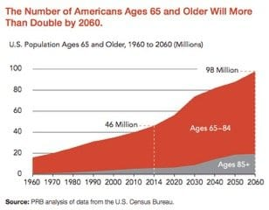
Introduction
g
65+ population will double by 2060.
Seniors require increase support in:
  Health services
  Advocacy
  Long-term Care
  Nutrition Services
How will we meet the demand?

Slide 3

Introduction
According to the 2010 census, PG County has 83,523 seniors.
Aging and Disabilities Services Division
Assisted Living Subsidies
Personal Assistant Program
Senior Nutrition Program
Senior Employment Program

Slide 4
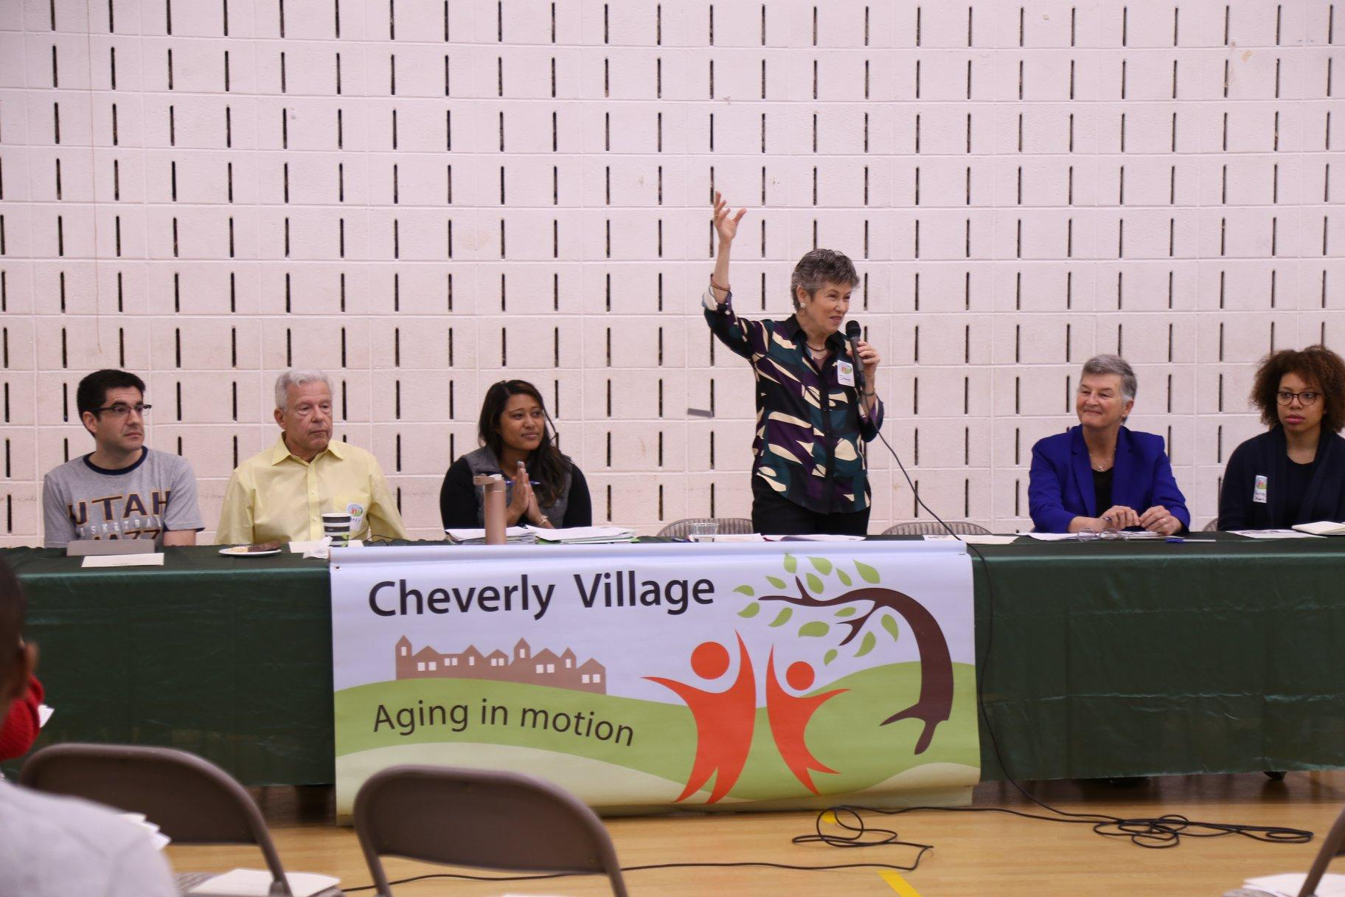
Introduction
The Village Movement: Aging in Place.
Allows seniors to remain in their homes.
Community-based non-profit organizations.
Provide collective support.
Socialization Opportunities. Practical Services.

Slide 5
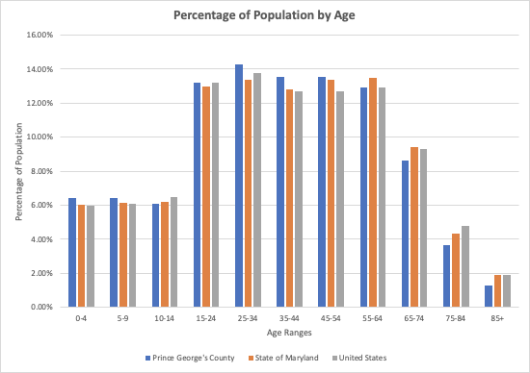
Community Assessment
Data: PGC Healthzone and Census.gov
Notes:
As shown in the table, in PG County the elderly population (age 65 and older) accounts for 13.56% of the total population. This is lower than the state of Maryland with 15.67% and the United States with 16.0%.

Slide 6
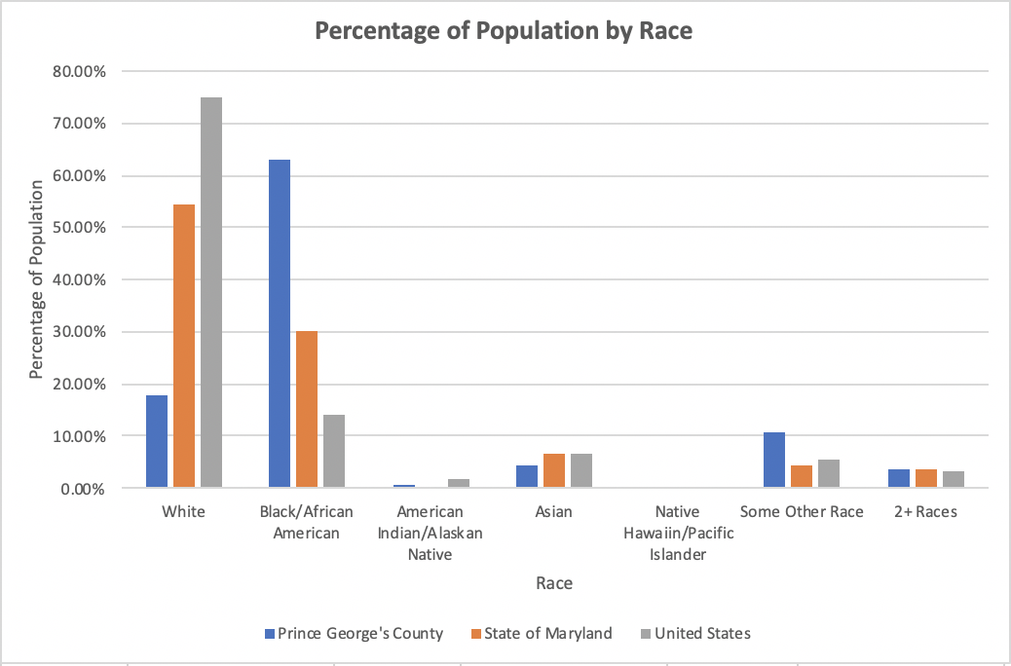
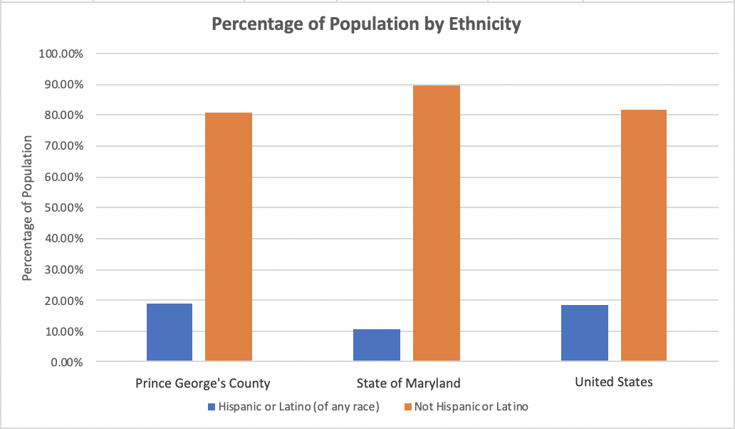
Community Assessment
Data: PGC Healthzone and Census.gov
Notes:
The racial demographics for PG county, Maryland and the United States were very interesting. Most people living in PG county identify as Black/African-American, making up 62.87% of the population. The majority of people in Maryland (54.54%) and in the whole United States (75.10%) identify as White. In PG County and the United States there is a growing number of people who identify as Hispanic or Latino and they occupy 18.98% and 18.3% of the population, respectively. In Maryland, however, the overall number of residents that identify as Hispanic/Latino make up only 10.49% of the population.

Slide 7
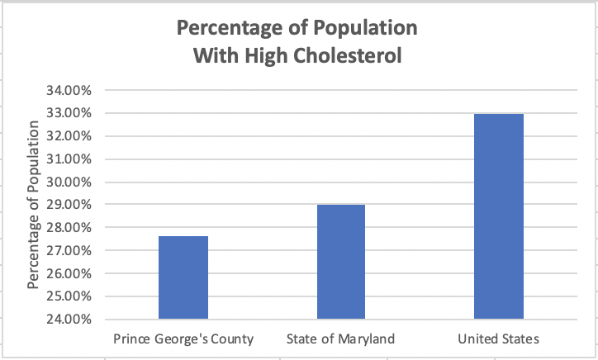
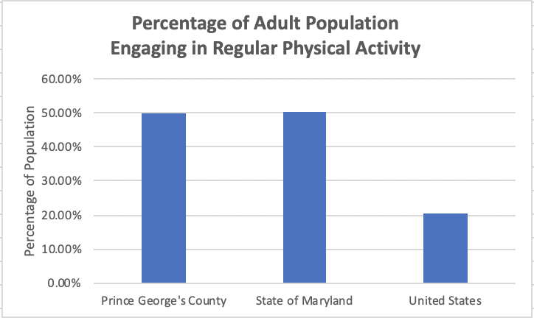
Community Assessment
Data: PGC Healthzone and Census.gov
Notes:
In PG county, 27.6% of the population has high cholesterol while 29% and 33% of the population have high cholesterol in Maryland and the United States, respectively.
PG county and the state of Maryland both have a similar percentage of the population of adults who engage in regular physical activity, with PG county having 50.1% and the state of Maryland having 50.4%. The United States, on the other hand, has only 20.3% of the population of adults who engage in regular physical activity.

Slide 8
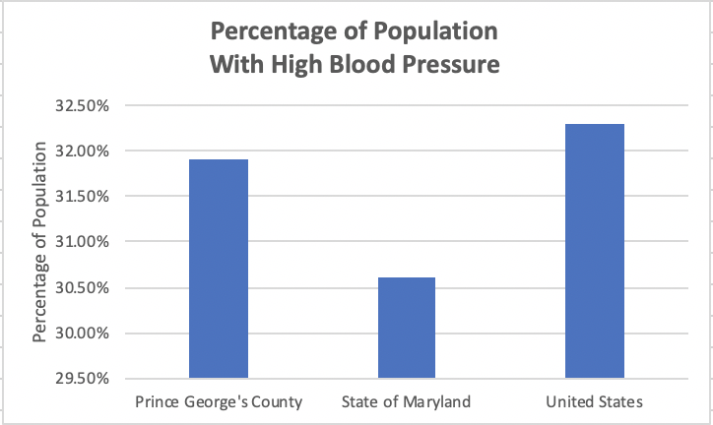
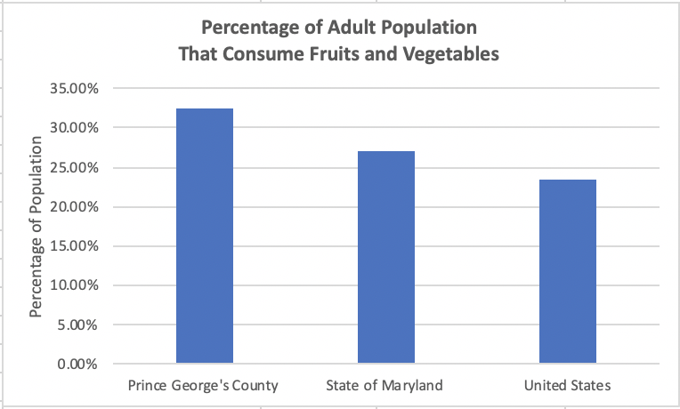
Community Assessment
Data: PGC Healthzone and Census.gov
Notes:
Regarding high blood pressure, 30.6% of Maryland’s population have this condition. This is less than the population percentage of both PG county (31.9%) and the United States (32.3%) with high blood pressure.
As indicated in the table below, the percentage of the adult population who consume fruits and vegetables is not very high in PG county, the state of Maryland, or in the entire United States. Only 32.4% of the adult population in PG county consume fruits and vegetables, while 27.1% and 23.4% consume fruits and vegetables in Maryland and the United States, respectively.

Slide 9
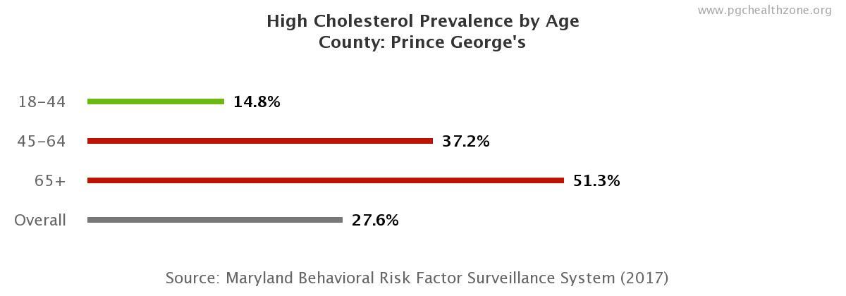
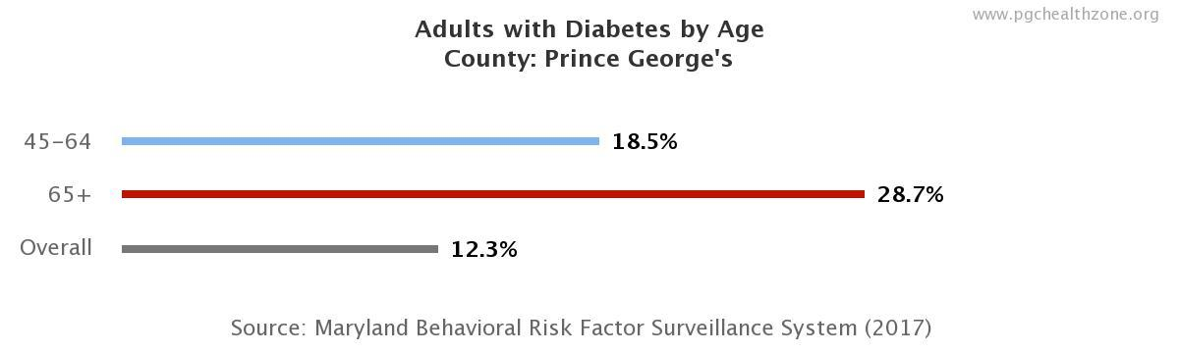
Target Group Assessment
51.3% of PG county’s elderly population has high cholesterol
28.7% of adults 65+ in PG county have diabetes

Slide 10
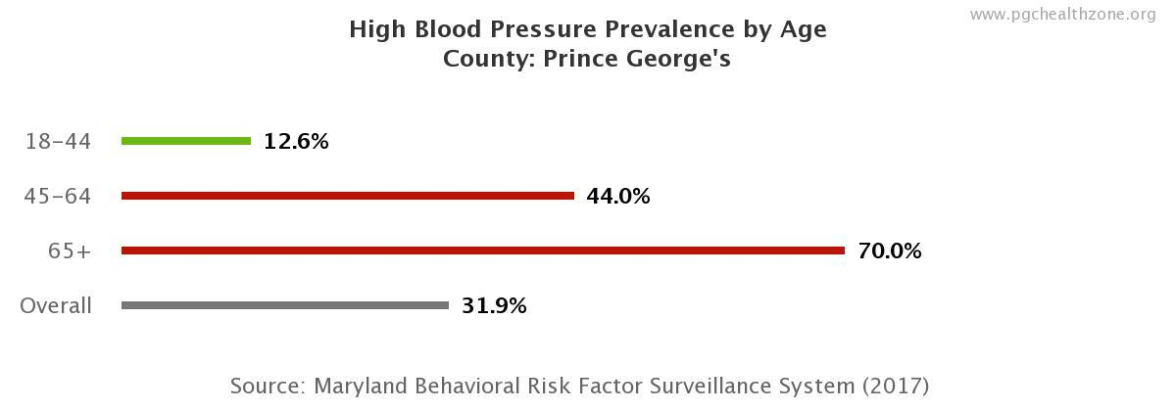
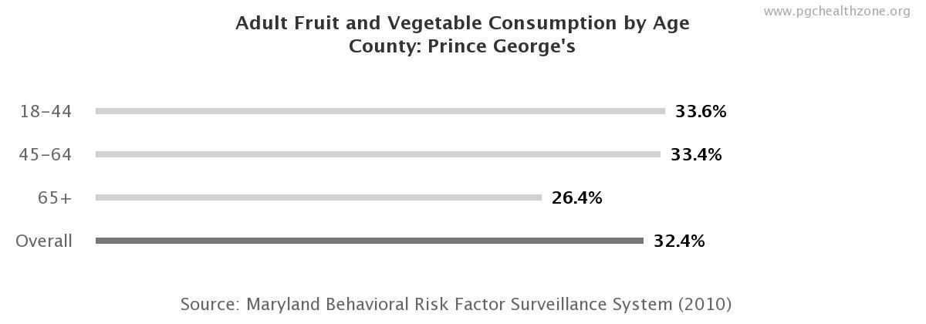
Target Group Assessment
70% of people in PG county aged 65+ have Hypertension
Only 26.4% of elderly people in PG county consume fruits and vegetables

Slide 11



Target Group Assessment
Resources Available
PG County State Office on Aging and Disabilities Services
  Nutrition Program: Home delivered meals and Congregate meals
  Health Promotion Program: Health screening, health education, medication management, etc.
PG County Department of Parks and Recreation
  Senior Days
  Club 300
Cheverly Village Movement
  Nature Walks
Notes:
Images from (left to right)
https://www.princegeorgescountymd.gov/2470/Seniors
https://cheverlyvillage.helpfulvillage.com/
http://www.pgparks.com/903/Seniors

Slide 12
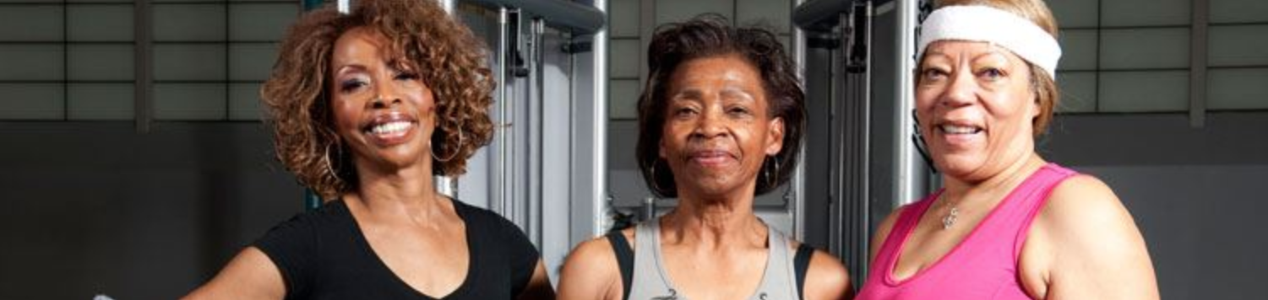
Target Group Assessment
Gaps in Resources
Travel
  Not in the community of Cheverly
Financial
  Income based programs excludes many seniors
Technology
  Access and ability to find resources
Notes:
Image from http://www.pgsportsandlearn.com/2989/Senior-Days

Slide 13
Intervention:
Cheverly Village Nutrition Program
Target population: Cheverly village movement- older adults aged 65 and up
Time frame: One year (May 2020 to May 2021)
Action: Reduce high blood pressure in older adults
Indication of Success: Decreased high blood pressure

Slide 14
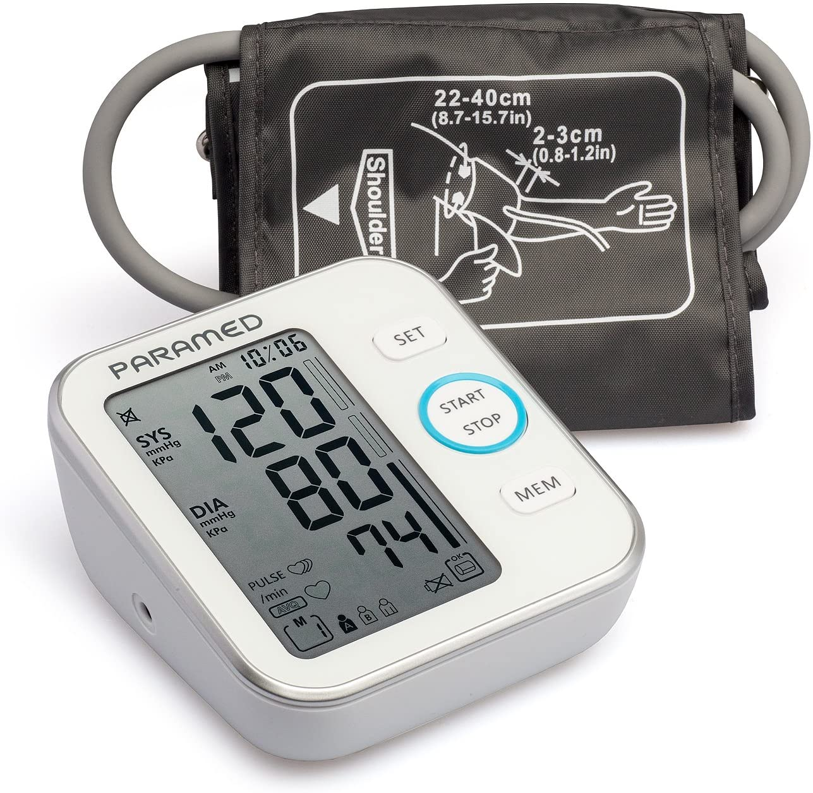

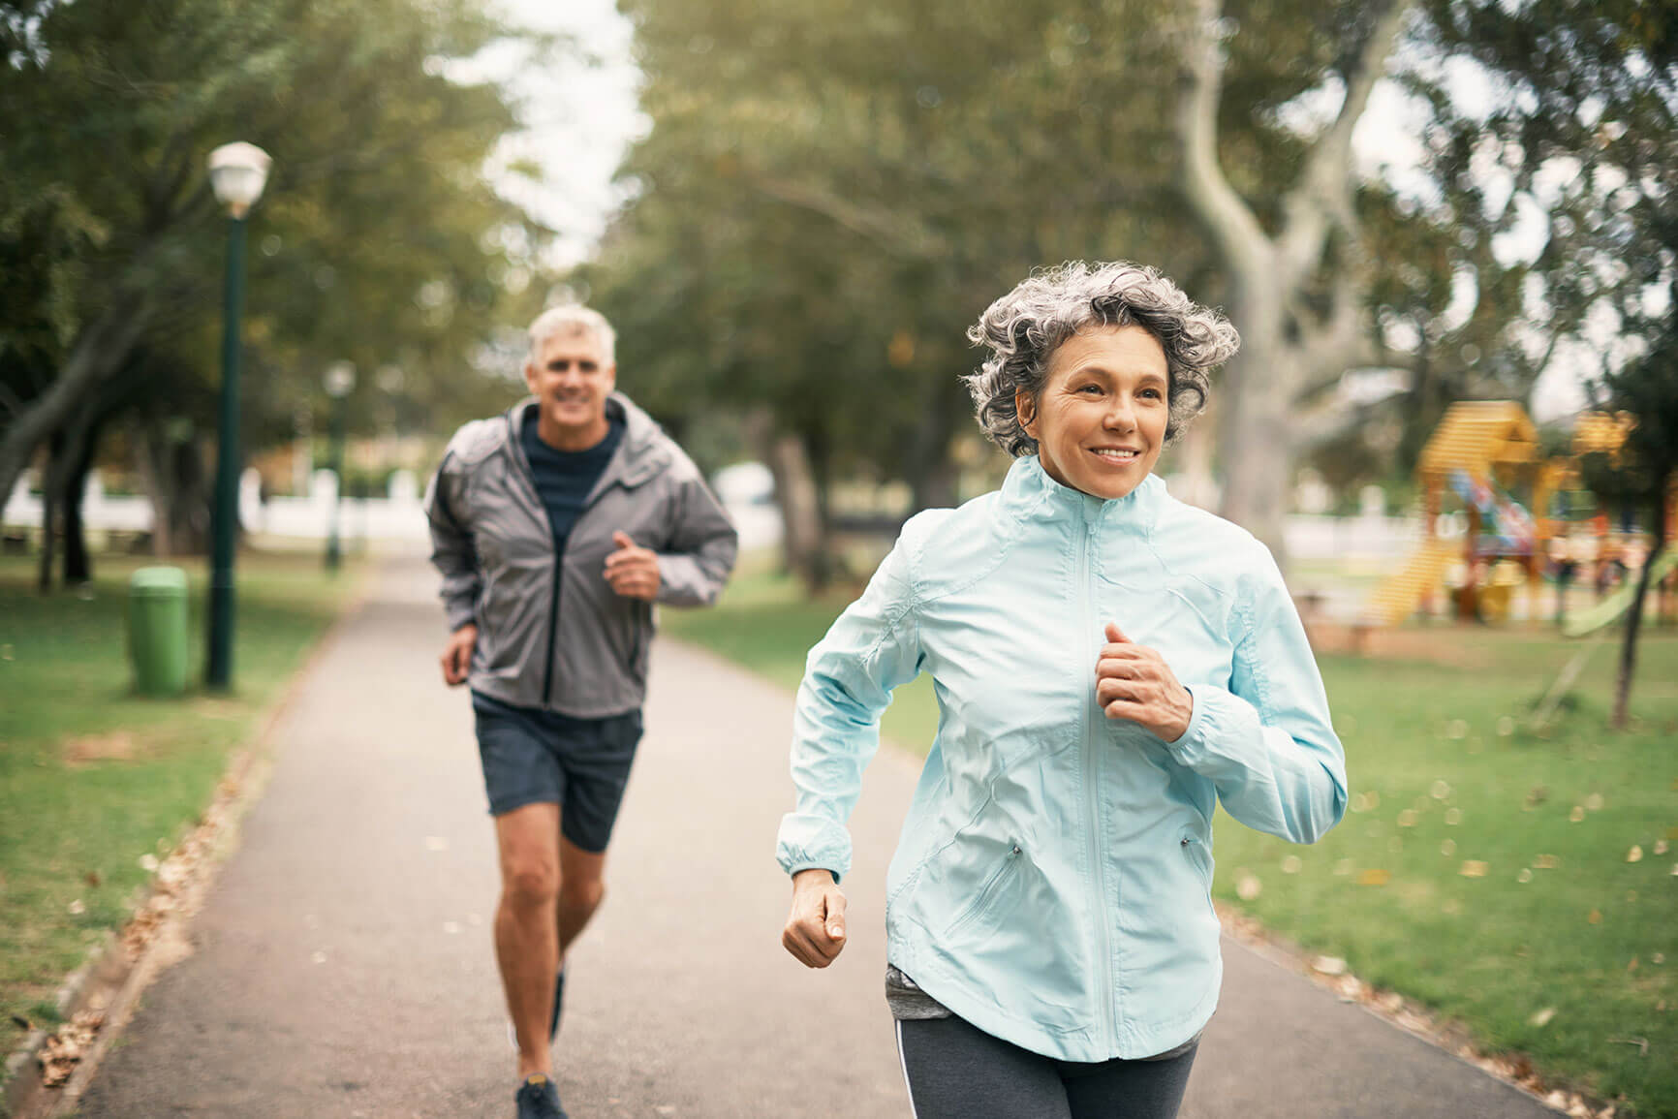
Intervention Design: Plan of Action
The goal of the Cheverly Village Nutrition Program is (1) to reduce high blood pressure, (2) improve fruit and vegetable intake, and (3) increase physical activity in adults ages 65 and up in the Cheverly Village movement.

Slide 15
Fruit and Vegetable Intake Objectives
Why (needs):
Low fruit and vegetable consumption
Travel limitations
Financial restrictions
Outcome:
Fruit and vegetable intake will increase by 2 servings per day by May 2021.
Indicator: Survey before and after
Process:
-Provide one produce bag weekly -Include 3 fruits and 3 vegetables in each produce bag -
Indicator: Inventory of bags and deliveries
Structure:
Provide one F & V chopper
Indicator: Survey (received or not; useful or not)

Slide 16
Blood Pressure Objectives
Why (needs):
Large percentage with HIgh Blood Pressure
Technology
Interaction
Outcome:
Decrease the mean blood pressure by 2% by May 2021
Indicator: Recording a chart of participants of BP measurements
Process:
-Meal prep tutorials
-Blood pressure measurement
Indicator: Sign-sheet to indicate tutorials and BP measurement given to participants
Structure
Hire 2 registered dietitians
Indicator: Note number of dietitians hired

Slide 17
Physical Activity Objectives
Why (Needs):
Travel limitations
Outcome:
Completion of 30 hours (30 minutes per week) of physical activity time by May 2021
Indicator:Time-log of hours completed of work-out sessions
Process:
Work out sessions of 15 minutes, 4 times a week -
Indicator: Recording the sessions provided
Structure:
2 physical activity lesson providers -
Indicator: Note how many were hired

Slide 18
Intervention Design: Community Leader Reflection
Diane LaVoy -Cofounder of Cheverly Village and interim Executive Director.
Villages differ greatly in amenities.
Currently do not have nutrition support
Increased need for insurance gap funding
Exercise and autonomy.
Weekly produce encouraging and interactive

Slide 19
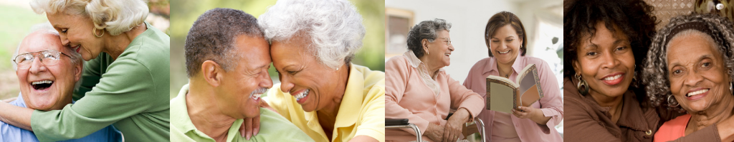
Conclusion
Seniors are a rapidly growing population that will require increased care.
Villages are an excellent vehicle to provide support while aging in place, allowing seniors to maintain their agency and autonomy .
Focusing dietary support on issues such as hypertension will be increasingly important in the near future.

